Slide 1
“There are two kinds of people in the world: those interested in sex, and liars.”
--Anonymous

Slide 2
Human Sexuality—The Cultural and Ecclesiological Landscape
C. Ben Mitchell, PhD
Graves Professor of Moral Philosophy
Union University
Adjunct Professor of Bioethics
Trinity Graduate School
Trinity Evangelical Divinity School

Slide 3
A Few Caveats
Our anthropology requires charity
Our language anticipates double entendres
Our calling demands compassion
Our experience requires humility
Our task calls for courage
Our responsibility requires us to contextualize the question.

Slide 4
Traditional Teaching on Sexuality and Marriage
One should refrain from sexual activity until marriage (i.e., the wedding).
An essential and normal (though not the only) purpose of marriage is to produce children.
One should refrain from sexual activity with anyone but one’s spouse.
One should choose a spouse from the opposite sex.
The marital estate is intended to be a permanent love relationship.

Slide 5
Today
Courtship is dying
Cohabitation is growing
Marriage is disintegrating
Pornography is pandemic
Sexual abuse by clergy is daily news
“Adult toys” industry is mainstream
Shades of Grey popularizes “mommy porn”
Promiscuous procreation
De-population is becoming problematic
No-fault divorce is rampant
Children are suffering
Polyamory is becoming increasingly acceptable

Slide 6
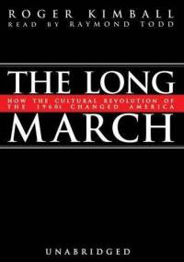
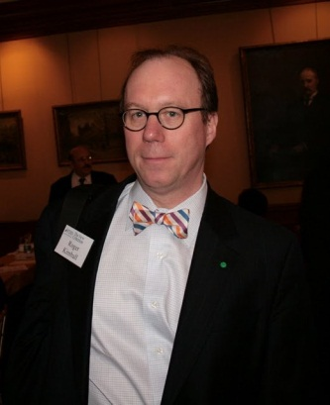
How did we get here?
A cultural revolution took place.
A cultural revolution, whatever the political ambitions of its architects, result first of all in a metamorphosis in values and the conduct of life.

Slide 7
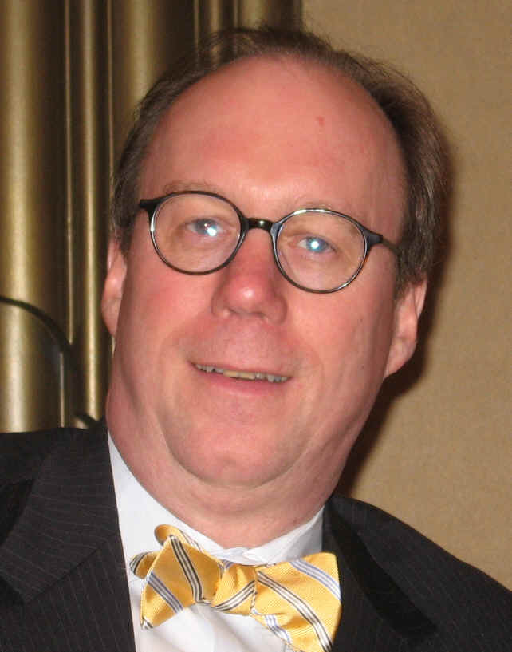
“The Age of Aquarius did not end when the last electric guitar was unplugged at Woodstock. It lives on in our values and habits, in our tastes, pleasures, and aspirations. It lives on especially in our educational and cultural institutions, and in the degraded pop culture that permeates our lives like a corrosive fog.”

Slide 8
“The movement for sexual ‘liberation’ (not to say outright debauchery) occupies a prominent place in the etiology of this revolution, as does the mainstreaming of the drug culture and its attendant pathologies. Indeed, the two are related. Both are expressions of the narcissistic hedonism that was an important ingredient of the counterculture from its development in the 1950s.”

Slide 9
“The real victory of the ‘youth culture’ of the Sixties lay not in the fact that its demands were met but in the fact that its values and attitudes were adopted by the culture at large.”
“. . . The idealization of youth has resulted not only in the spread of adolescent values and passions: it has also led to the eclipse of adult virtues like circumspection, responsibility, and restraint.”

Slide 10
“That ideology has insinuated itself, disastrously, into the curricula of our schools and colleges; it has significantly altered the texture of sexual relations and family life; it has played havoc with the authority of the churches and other repositories of moral wisdom; it has undermined the claims of civic virtue and our national self-understanding; it has degraded the media, the entertainment industry, and popular culture; it has helped to subvert museums and other institutions entrusted with preserving and transmitting high culture. I has even, most poignantly, addled our hearts and innermost assumptions about what counts as the good life: it has perverted our dreams as much as it has prevented us from attaining them.”

Slide 11
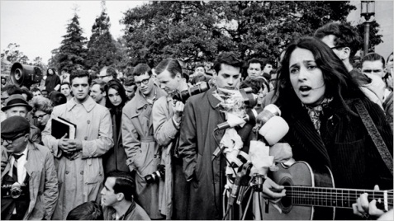
“the nasty things that were done in the late Sixties and transmitted to us . . . Are neither so outrageous nor so violent as at first. The poison has worked its way into our souls, the effects becoming less visible to us as they become more ordinary. Even those who reject the Sixties unconsciously concede more than they know to the vicious principle of liberation that was once shouted into the street microphone.”

Slide 12
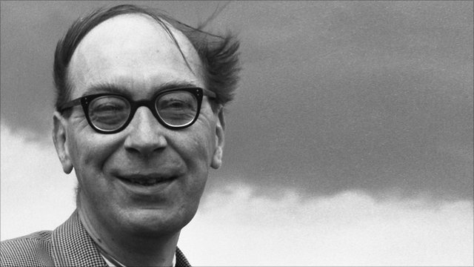
Phillip Larkin (1922-1985)
Annus Mirabilis
Sexual intercourse began In nineteen sixty-three (which was rather late for me) - Between the end of the "Chatterley" ban And the Beatles' first LP.

Slide 13
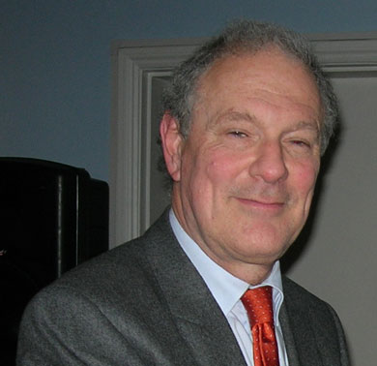
“In the modern view, unbridled personal freedom is the only good to be pursued; any obstacle to it is a problem to be overcome.”
“The only permissible judgment in polite society is that no judgment is permissible.”
“Having been issued the false prospectus of happiness through unlimited sex, modern man concludes, when he is not happy with his life that his sex has not been unlimited enough.”

Slide 14
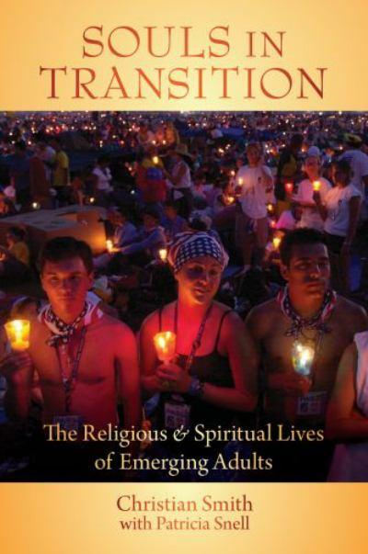
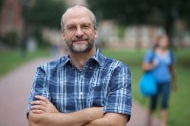
Souls in Transition
They are:
Soft ontological anti-realists
Epistemological skeptics
Perspectivalists
“. . . imprisoned in their own subjective selves, limited to their biased interpretations of their own sense perceptions, unable to know the real truth of anything beyond themselves.”
“Most emerging adults [18-24] have great difficulty grasping the idea that a reality that is objective to their own awareness or construction of it may exist that could have significant bearing on their lives”

Slide 15
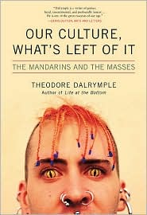
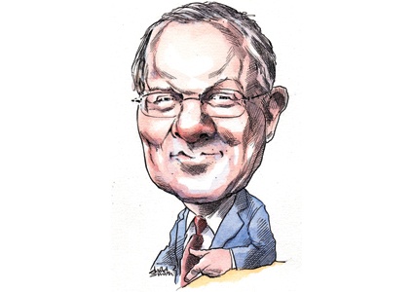
“When young people want to praise themselves, they describe themselves as ‘non-judgmental.’ For them, the highest form of morality is amorality.”

Slide 16
The Great Divide
Conjugal marriage view
“Marriage is intrinsically a sexual union of husband and wife, because these are the only unions that can make new life and connect those children in love to their co-creators, their mother and father.”
“Marital unions are those capable of uniting goods that otherwise tend to fragment, with high social costs: sex, love, caretaking, babies, and mothers and fathers.”
Maggie Gallagher, in Corvino and Gallagher, Debating Same-Sex Marriage (OUP, 2012)
Revisionist marriage view
“Marriage is the union of two people who commit to romantic partnership and domestic life: essentially an emotional union, merely enhanced by whatever sexual activity the partners find agreeable.”
Sherif Girgis, Ryan T. Anderson, and Robert P. George, What is Marriage? Woman and Man: A Defense (Encounter, 2012).

Slide 18
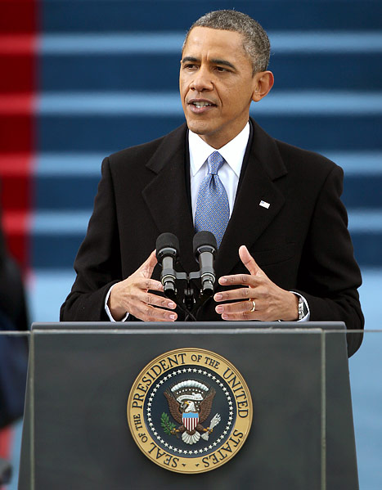
Seneca
Selma
Stonewall

Slide 19
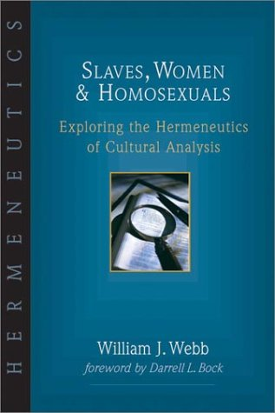
Cultural Context/Accommodationist Approach

Slide 20
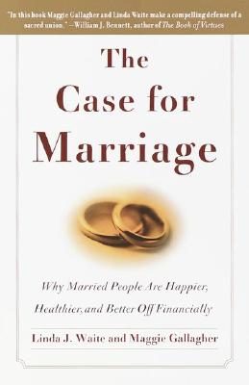
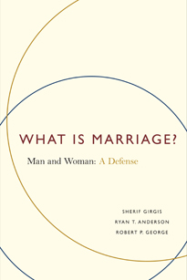
Natural Law-Consequentialist Approach

Slide 21
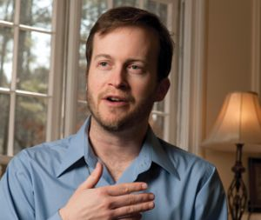
Separationist/Let’s Get On With It Approach
My Take: Christians Ought to
Shrug Off Inaugural Pastor Rejection
Is it Time for Evangelicals to Stop
Opposing Gay Marriage?

Slide 22
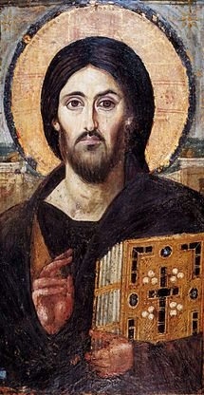
Prophetic/Pastoral Witness Approach
“Have you not read that he who created them from the beginning made them male and female, and said, ‘Therefore a man shall leave his father and mother and hold fast to his wife, and the two shall become one flesh’? So they are no longer two but one flesh. What therefore God has joined together, let not man separate.”
Matthew 19:4-6 ESV

